Slide 1
CS5560 Knowledge Discovery Management Tutorial 2
30th Jan 2020
UMKC

Slide 2
Overview
Natural Language Processing using CoreNLP
Part-of-speech (POS) tagger
Named entity recognizer (NER)
Co-reference resolution system
Sentiment analysis

Slide 3
Task for this Tutorial
POS Tagging
Sentiment Analysis
TEXT
Named Entity Recognition
Co-referencing

Slide 4
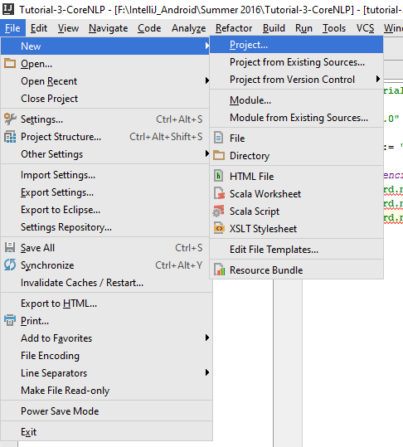
Creating a Pycharm Project
To create a New Pycharm Project.
Go to File -> New Project

Slide 5
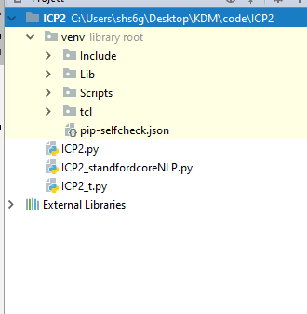
Creating Python file
Right Click on project file -> New ->python file

Slide 6
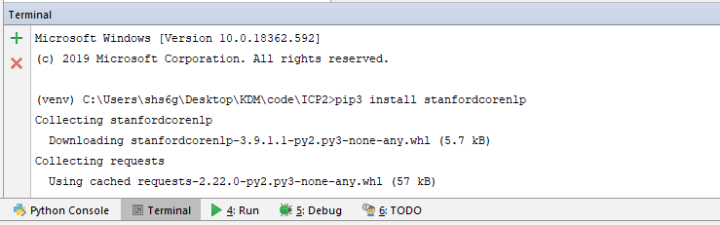
Adding Library to python file
Go to terminal->pip install stanfordcorenlp

Slide 7
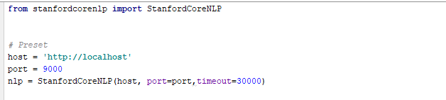
Stanford CoreNLP API
Standford CoreNLP API (http://stanfordnlp.github.io/CoreNLP/api.html)
This API uses Annotators Pipeline approach to implement all the NLP processing.

Slide 8

Setting Up the environment
Download Stanford CoreNLP from the following link:
https://stanfordnlp.github.io/CoreNLP/
Unzip and save the folder to your desired location

Slide 9

Setting Up the environment
Also download the English language jar file and save it within the CoreNLP unzip folder

Slide 10
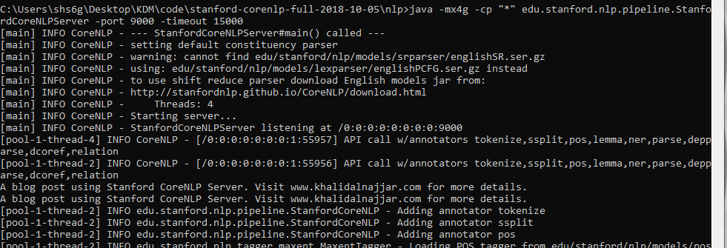
Running the Stanford NLP server in local machine
In the command prompt navigate to the location which has Unzip folder and type the following command
java -mx4g -cp "*" edu.stanford.nlp.pipeline.StanfordCoreNLPServer -port 9000 -timeout 15000

Slide 11
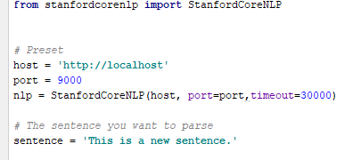
Setting the connection

Slide 12

Tokens of the text

Slide 13

Lemmatization
Lemmatization usually refers to doing things properly with the use of a vocabulary and morphological analysis of words, normally aiming to remove inflectional endings only and to return the base or dictionary form of a word, which is known as the lemma .

Slide 14
Parts of Speech Tagging
Text : "And now for something completely different“
POS Tagging:
[('And', 'CC'), ('now', 'RB'), ('for', 'IN'), ('something', 'NN'), ('completely', 'RB'), ('different', 'JJ')]
Part-Of-Speech Tagger (POS Tagger) is a piece of software that reads text in some language and assigns parts of speech to each word (and other token), such as noun, verb, adjective, etc., although generally computational applications use more fine-grained POS tags like 'noun-plural'.

Slide 15
POS Tags Table (for English)
Number | Tag | Description
1. | CC | Coordinating conjunction
2. | CD | Cardinal number
3. | DT | Determiner
4. | EX | Existential there
5. | FW | Foreign word
6. | IN | Preposition or subordinating conjunction
7. | JJ | Adjective
8. | JJR | Adjective, comparative
9. | JJS | Adjective, superlative
10. | LS | List item marker
11. | MD | Modal
12. | NN | Noun, singular or mass
13. | NNS | Noun, plural
14. | NNP | Proper noun, singular
15. | NNPS | Proper noun, plural
16. | PDT | Predeterminer
17. | POS | Possessive ending
18. | PRP | Personal pronoun
Number | Tag | Description
19. | PRP$ | Possessive pronoun
20. | RB | Adverb
21. | RBR | Adverb, comparative
22. | RBS | Adverb, superlative
23. | RP | Particle
24. | SYM | Symbol
25. | TO | to
26. | UH | Interjection
27. | VB | Verb, base form
28. | VBD | Verb, past tense
29. | VBG | Verb, gerund or present participle
30. | VBN | Verb, past participle
31. | VBP | Verb, non-3rd person singular present
32. | VBZ | Verb, 3rd person singular present
33. | WDT | Wh-determiner
34. | WP | Wh-pronoun
35. | WP$ | Possessive wh-pronoun
36. | WRB | Wh-adverb
Ref: http://www.ling.upenn.edu/courses/Fall_2003/ling001/penn_treebank_pos.html

Slide 16

Parts of Speech Tagging

Slide 17
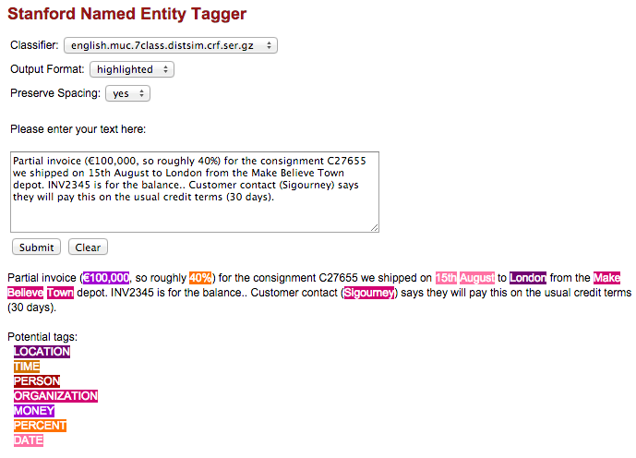
Named Entity Recognition
Recognizes named (PERSON, LOCATION, ORGANIZATION, MISC), numerical (MONEY, NUMBER, ORDINAL, PERCENT), and temporal (DATE, TIME, DURATION, SET) entities.

Slide 18
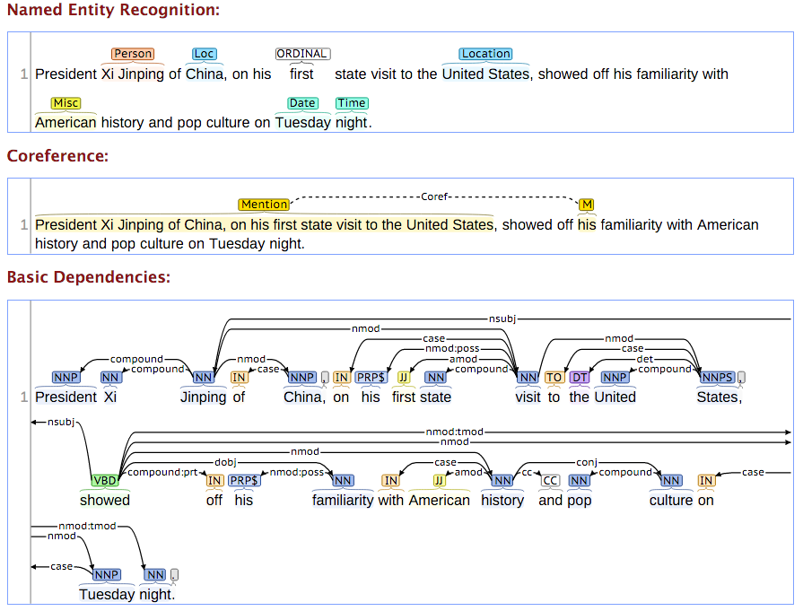
Named Entity Recognition

Slide 19

Named Entity Recognition

Slide 20
Co-referencing
Co-reference occurs when two or more expressions in a text refer to the same person or thing; they have the same referent, e.g. Bill said he would come; the proper noun Bill and the pronoun he refer to the same person, namely to Bill. Coreference is the main concept underlying binding phenomena in the field of syntax.

Slide 21
Co-referencing Properties Available
dcoref.demonym // The path for a file that includes a list of demonyms
dcoref.animate // The list of animate/inanimate mentions (Ji and Lin, 2009)
dcoref.inanimate
dcoref.male // The list of male/neutral/female mentions (Bergsma and Lin, 2006)
dcoref.neutral // Neutral means a mention that is usually referred by 'it'
dcoref.female
dcoref.plural // The list of plural/singular mentions (Bergsma and Lin, 2006)
dcoref.singular

Slide 22
Reference
Core NLP : http://stanfordnlp.github.io/CoreNLP/
Natural Language Processing: Parsing :
https://umkc.box.com/s/eoc0h80vn5o6szz7jbfr9k5pmywv0wmb

